Slide 1
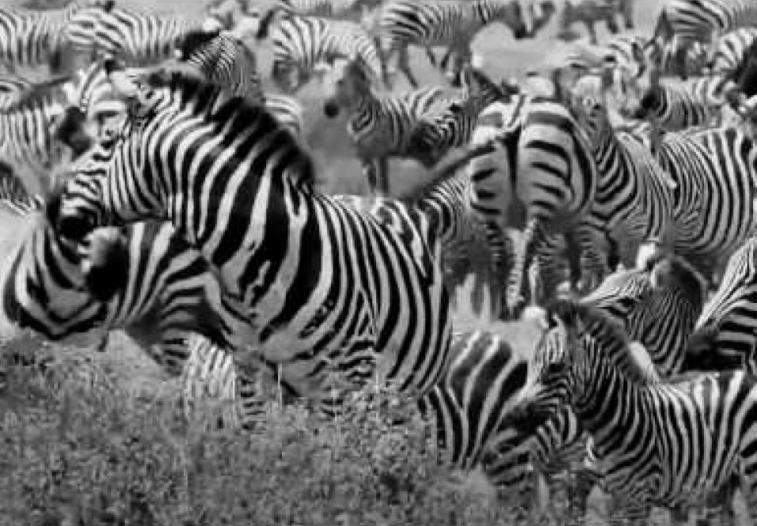
Natural Selection

Slide 2

Genetic Equilibrium
(Revision of level 2 Biology)
Five conditions are required in order for a population to remain at equilibrium (not evolve):
  1. A large breeding population
  2. Random mating
  3. No mutations
  4. No immigration or emigration
  5. No natural selection

Slide 3
Natural Selection
More individuals are born than can survive.
If genetic variation exists, some individuals will be better fitted to survive and reproduce.
Their phenotypes are more successful and so will be “selected”.
The “fitter” individuals will contribute more alleles to the gene pool.
Allele frequencies will change over time, successful alleles will increase in frequency while unsuccessful alleles will decrease.
Selection pressures will shape the species to better suit the present conditions.

Slide 4
Types of Natural Selection
Three types
  Stabilising
    Maintains allele frequencies
  Directional
    Favours one extreme
  Disruptive
    Favours both extremes but not the average

Slide 5
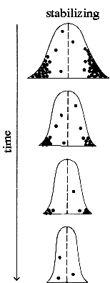
Stabilising Selection
(Black dots represent individuals who die out before passing on their genes)
Average phenotype selected for, – extremes selected against
E.g. Human birth weight – before medical intervention became possible

Slide 6
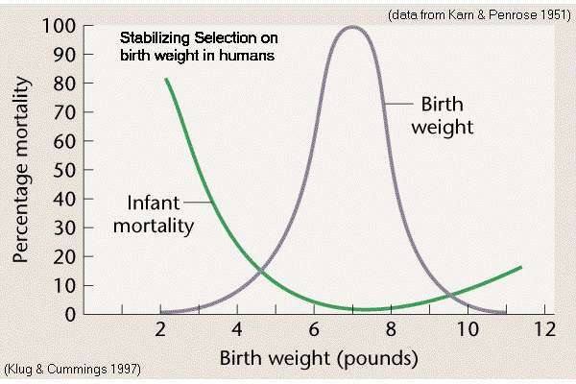
Human Birth Weights

Slide 7
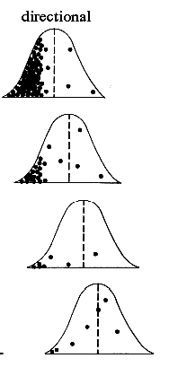
Directional Selection
One extreme is selected against and/or the other extreme is selected for
E.g. Non-pesticide resistant pests
Peppered moths

Slide 8
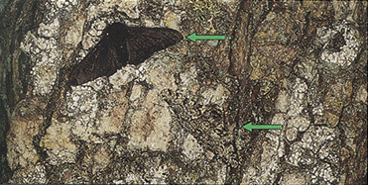
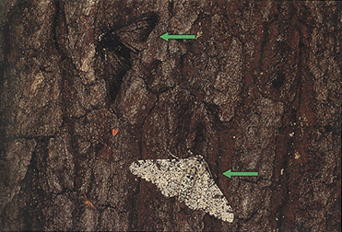
Peppered moths
Melanic (black) moths were selected against before the industrial revolution.
Light ones were selected against after the trees became covered with soot
Dark moth
Light moth
Dark moth
Light moth

Slide 9
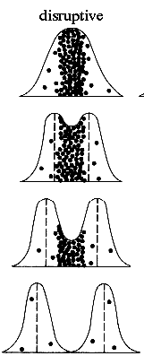
Disruptive Selection
The mean is selected against
E.g. Bill size in African finches

Slide 10
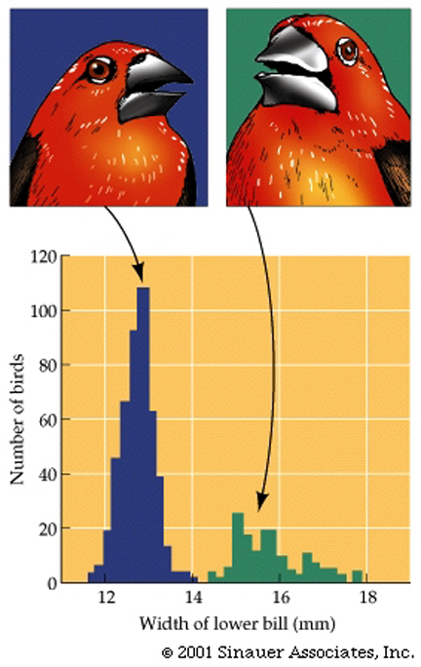
Disruptive Selection
An example of "Disruptive selection": can be seen in the "black-bellied seed cracking finches of West Africa, wherein the selective pressure of obtaining food, has effectively divided the population into two, quite distinctive distributions, based upon their bill type.

Slide 11
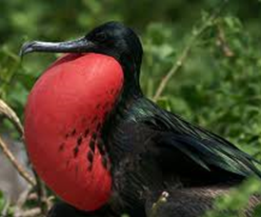
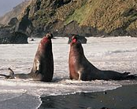
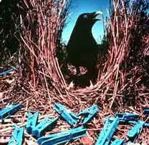
Sexual Selection
Special form of selection in which one gender or both select their mate based on physical or behavioural traits e.g. colour, size of organs (e.g. long tail), ability to acquire territory or win fights

Slide 12


